Slide 1
NBA Player Statistical Data Analysis
Tim Chen, Ying Jiang, Mohamed ALshamsi

Slide 2
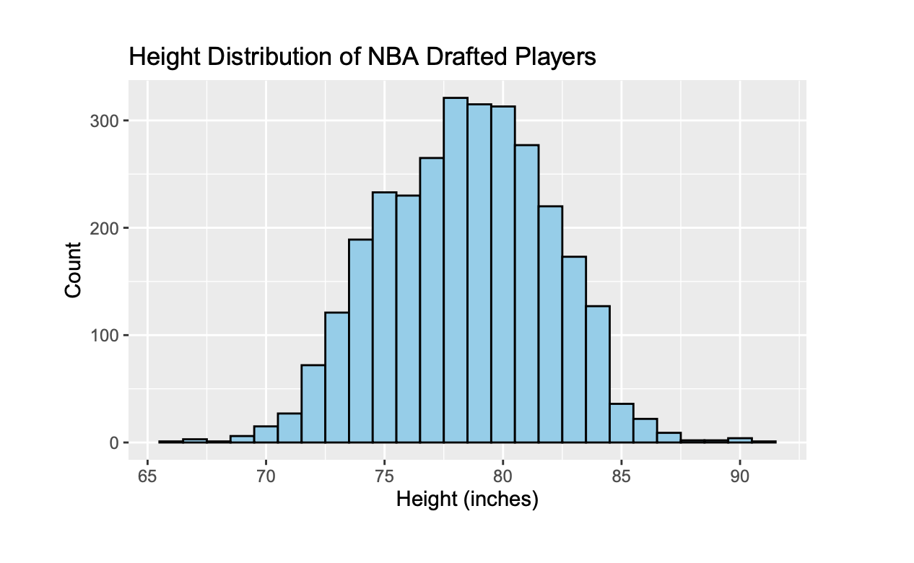
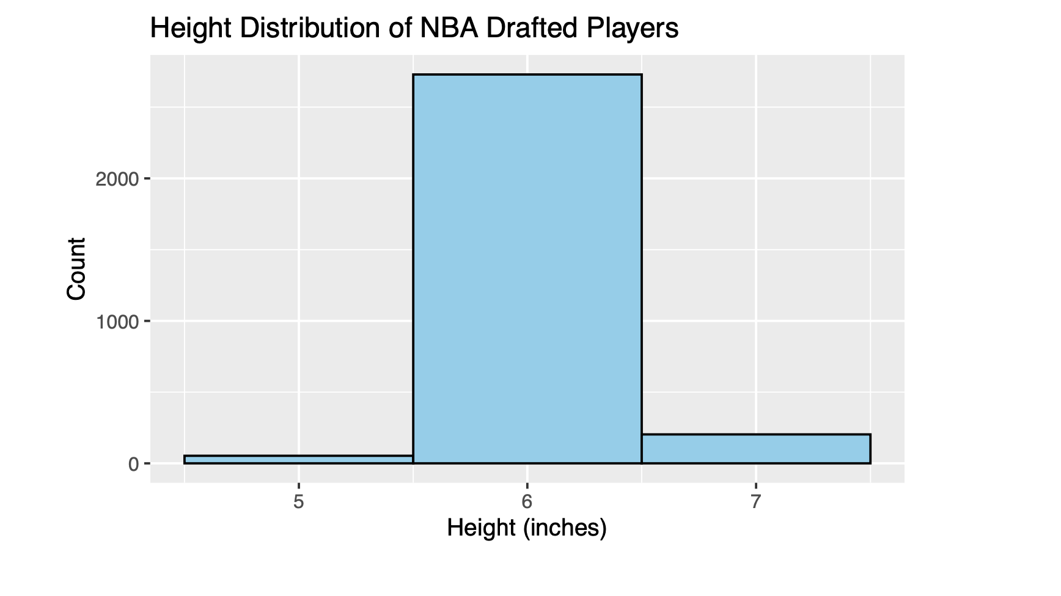
Height Distribution

Slide 3
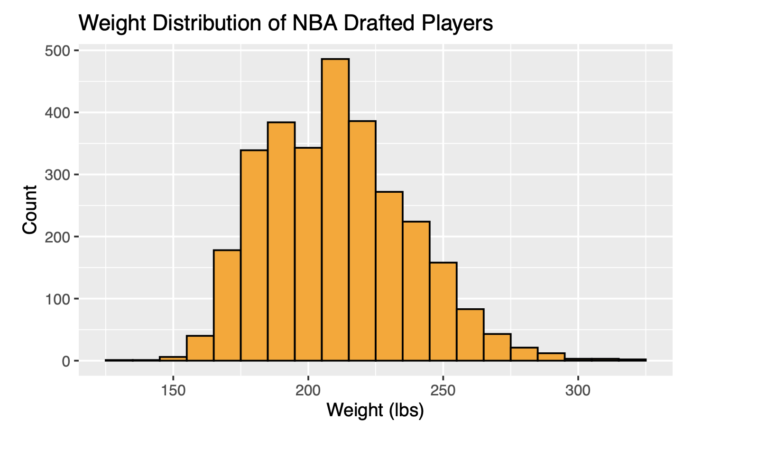
Weight Distribution

Slide 4
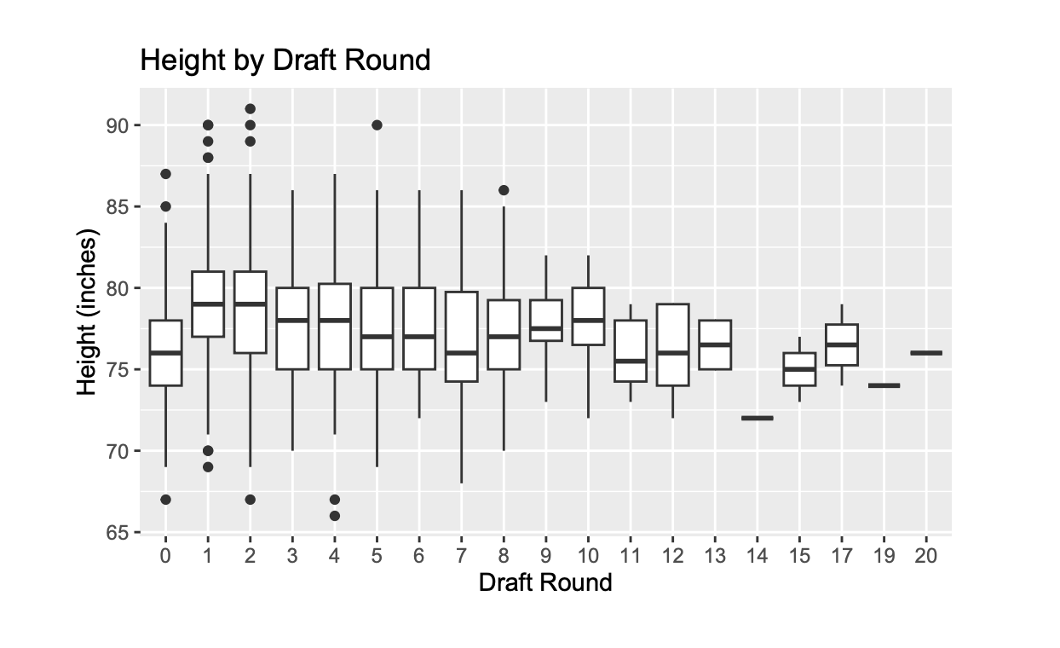
Draft Round vs Height

Slide 5
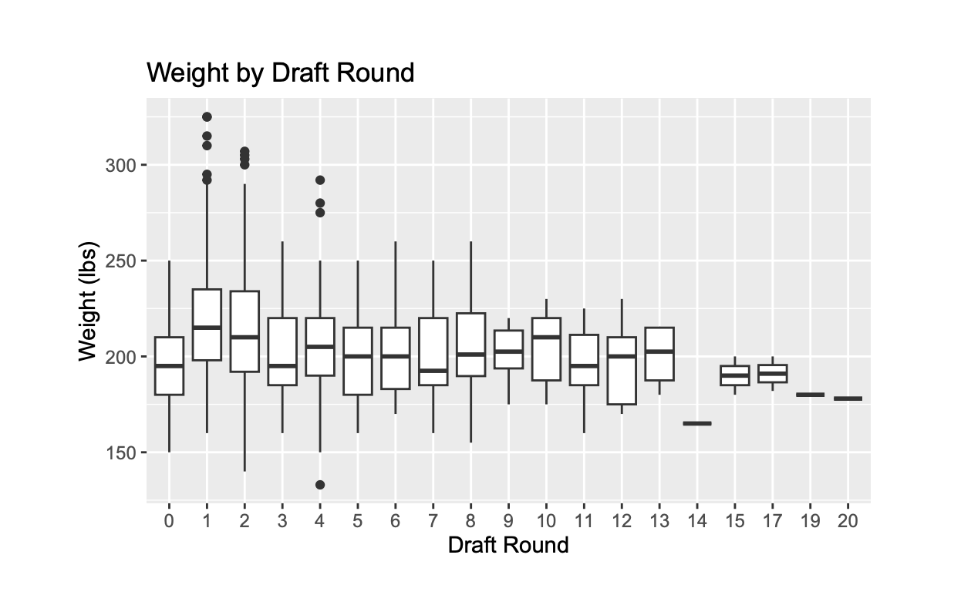
Draft Round vs Weight

